Slide 1
Dell Hymes SPEAKING Analysis
Ryansen, Reyven Edward Michael

Slide 2
Introduction
Communication is fundamental aspect of human interaction, and understanding how people communicate in different social situations is essential in sociolinguistics. Dell Hymes introduced the SPEAKING model as a framework for analyzing speech events by examining their components, such as setting, participants, ends, and genre. This model helps researchers understand not only what is said, but also how and why it is spoken within a cultural context.

Slide 3
Introduction
In this study, the conversation between two speakers Liam and Maya discussing travel plans to Indonesia is analyzed using Hymes’ SPEAKING framework. The dialogue takes place in a casual café setting, and it reflects natural, friendly communication where advice, cultural information, and personal experiences are shared. The purpose of this analysis is to identify and explain all SPEAKING components present in the conversation and demonstrate how they contribute to the meaning and function of the interaction.

Slide 4
Dialog
Liam: Maya, it’s nice to finally hang out again. This café is always so relaxing.
Maya: I know, right? The atmosphere here is perfect for talking. So, what’s new with you?
Liam: Well… guess what? I’m finally taking a trip to Indonesia next month!
Maya: Wow, seriously? That’s amazing! Where are you planning to go?
Liam: I’m starting in Jakarta for a couple of days, then I’ll fly to Bali.
Maya: Good choice. Jakarta can be crowded, but the food is totally worth it.
Liam: Yeah, I really want to try authentic nasi goreng and sate.

Slide 5
Dialog
Maya: You definitely should. And don’t forget martabak it’s one of the best desserts ever.
Liam: I already added it to my list. What about Bali? Any places I shouldn’t miss?
Maya: For sure! Go to Ubud for the rice terraces and culture. It’s so peaceful.
Liam: I’ve seen pictures. It looks beautiful.
Maya: It is. And if you like beaches, you should visit Nusa Penida or Kuta.
Liam: I'm planning to snorkel there. I heard the water is really clear.
Maya: Yep, you can even see manta rays if you’re lucky.

Slide 6
Dialog
Liam: That sounds amazing. How about the weather?
Maya: It’s warm and humid, so bring light clothes. And sunscreen a lot of sunscreen.
Liam: Noted. Is Bahasa Indonesia hard to learn?
Maya: Not really. Some basic phrases are super easy.
Liam: Like what?
Maya: “Terima kasih” means thank you, “tolong” means please, and “permisi” is excuse me.
Liam: Nice! I’ll practice those.
Maya: Indonesians really appreciate when foreigners try to speak the language. It makes interactions smoother.

Slide 7
Dialog
Liam: Good to know. Now I’m even more excited.
Maya: You should be! Indonesia has amazing nature, culture, and food.
Liam: Thanks for the tips, Maya. I’ll send you photos when I get there.
Maya: Please do! And enjoy your trip!

Slide 8
SPEAKING Analysis

Slide 9
Settings & Scene
Physical Circumstance
The meeting takes place on a Saturday afternoon at a café where Liam and Maya are having a casual conversation.
Psychological Setting
Liam and Maya engage in a friendly talk about travel plans, experiences, and giving each other advice.
Cultural Scene (Informal)
The situation is informal because they talk casually about food, places to visit, and simple Indonesian phrases.

Slide 10
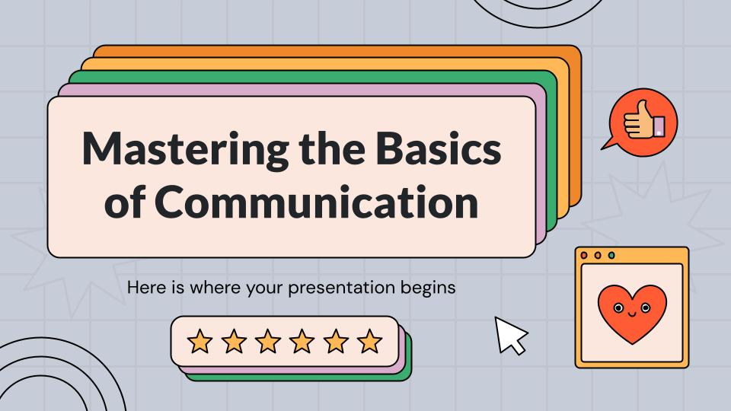
Participants
The Speaker
Liam and Maya.
The Hearer
Liam and Maya.
Explanation
Both Liam and Maya act as speakers and hearers,
taking turns asking questions, answering, and
sharing information about traveling to Indonesia.

Slide 11

Ends
Participants’ Purpose
To discuss Liam’s upcoming trip to Indonesia.
To share information about destinations, food, weather, and basic phrases.
General Experience
Maya shares her experiences and knowledge about Indonesia.
Liam shows excitement and interest in traveling.
The conversation is informal, focusing on travel plans, recommendations, and friendly advice.

Slide 12

Act of Sequence
1. Liam and Maya sit together in a café and talk about how relaxing the place is.
2. Liam tells Maya that he will travel to Indonesia next month.
3. Maya responds excitedly and asks where he plans to go.
4. Liam explains that he will visit Jakarta and Bali.

Slide 13
Act of Sequence
5. Maya gives recommendations about food in Jakarta and places to visit in Bali like Ubud and Nusa Penida.
6. Liam talks about wanting to snorkel and asks about the weather.
7. Maya advises him to bring light clothes and sunscreen.
8. Liam asks whether Bahasa Indonesia is hard to learn.

Slide 14
Act of Sequence
9. Maya teaches him simple phrases like “terima kasih,” “tolong,” and “permisi.”
10. Liam shows excitement and says he will practice the phrases.
11. Maya tells him Indonesians appreciate foreigners who try to speak the language.
12. Liam thanks Maya for the tips and says he will send pictures during his trip.
13. Maya ends the conversation by wishing him a great trip.

Slide 15
Key
Liam’s Attitude
Liam is very excited and curious about his upcoming trip to Indonesia.
Maya’s Attitude
Maya is enthusiastic and happy while giving travel and cultural advice.
Explanation
Liam shows interest in visiting Jakarta and Bali and learning Indonesian culture.
Maya responds with friendly enthusiasm, offering tips on food, places, weather, and simple phrases.

Slide 16
Instrumentalities
They use informal language
Explanation:
In this dialogue, there are no instruments such as tools or devices involved. However, we can observe the type of language used: informal and casual English, suitable for friendly conversation. They speak naturally, using everyday vocabulary to talk about travel and culture in a relaxed setting.

Slide 17
Norms
This conversation occurs because Liam wants information and advice about traveling to Indonesia, and Maya wants to share her knowledge and help him prepare. They communicate politely, take turns speaking, and maintain a friendly and cooperative interaction.

Slide 18
Genre
This dialogue is talking about travel experiences and travel planning

Slide 19
Conclusion
The conversation forms a clear and cohesive speech event with a friendly, informal tone. All SPEAKING components support effective communication: a relaxed café setting, friendly participants, the purpose of sharing travel information, and a natural flow of dialogue. The tone is supportive, the language is informal with cultural phrases, and the norms show polite turn-taking. The genre is a casual travel-related conversation, demonstrating how social context shapes meaning.

Slide 20
Thanks
Do you have any questions?
Please keep this slide for attribution

